Slide 1

CALL OF DUTY Market Overview
Phạm Chí Đức

Slide 2
AGENDA
1. Overview
2. Market Trend
3. Insight
4. Recommendations

Slide 3

OVERVIEW

Slide 4

OVERVIEW
We are business analyst for Call of Duty division in Activision. We are presenting to the management of Activision on market analysis and insights of the game sales performance and providing recommendations to improve game sales.
Target Period: 2008 – 2024 (7th , 8th generation of game console)
7 Variables in the working dataset
Year: 1971 – 2024 ( years)
Rank: 64,016
Name: 11,322
Platform: 81
Genre: 20
Publisher: 3,383
Sales (in millions of copies): NA, EU, JP, Other & Global
Citations: https://www.pwc.com/gx/en/industries/tmt/media/outlook/insights-and-perspectives.html https://www.ey.com/en_us/insights/media-entertainment/what-s-possible-for-the-gaming-industry-in-the-next-dimension
https://www.theesa.com/wp-content/uploads/2024/05/Essential-Facts-2024-FINAL.pdf
https://www.theesa.com/resources/essential-facts-about-the-us-video-game-industry/2023-2/

Slide 5
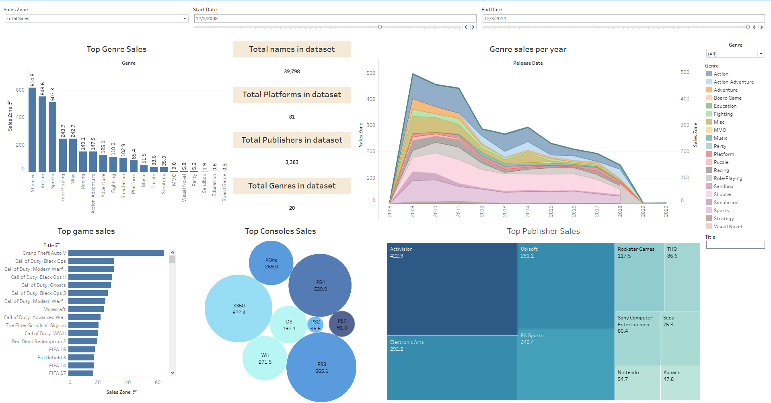

Slide 6
MARKET TREND

Slide 7
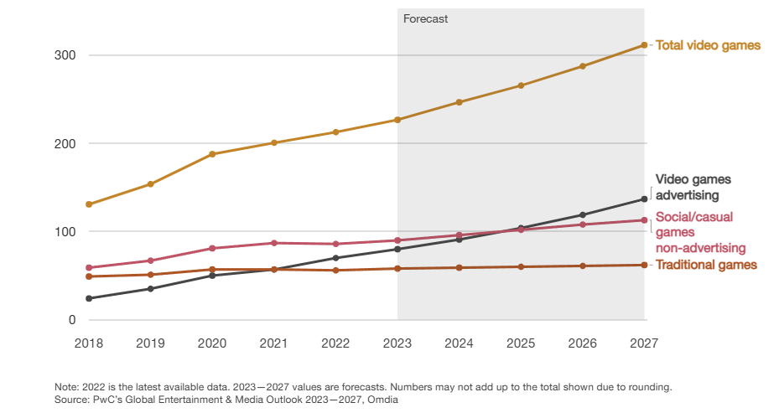
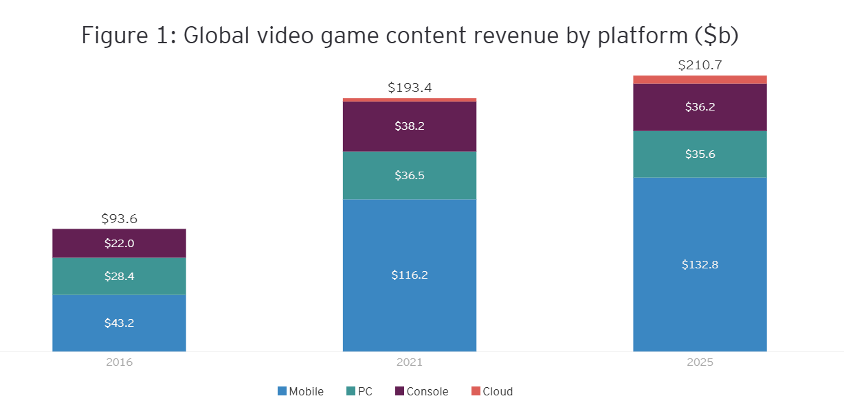
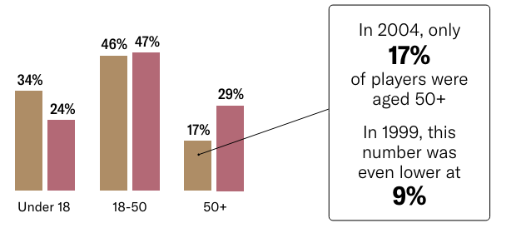
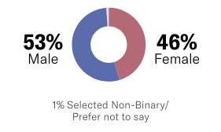
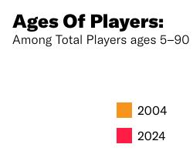

VIDEO MARKET
TOTAL REVENUE
PLATFORM
Global Revenue (US$ billion)
Global video game content revenue by platform (US$ billion)
GENDER DEMOGRAPHIC
AGE DEMOGRAPHIC
Citations: https://www.pwc.com/gx/en/industries/tmt/media/outlook/insights-and-perspectives.html https://www.ey.com/en_us/insights/media-entertainment/what-s-possible-for-the-gaming-industry-in-the-next-dimension
https://www.theesa.com/wp-content/uploads/2024/05/Essential-Facts-2024-FINAL.pdf
https://www.theesa.com/resources/essential-facts-about-the-us-video-game-industry/2023-2/
Notes:
Gaming industry have grown over the years. Several reasons for this growth has been the increase in internet penetration (how many ppl have access to wifi). In recent years, the COVID pandemic has resulted in more people playing games. Based on figures from PwC, the total gaming revenue is expected to rise from U$213bn to U$312bil in 2027. I can further look at the gaming revenue breakdown by platforms. I see that there is mostly 4 platforms, mobile, pc, console, cloud.
The demographics of players is roughly equal at 53% male and 46% female with most players in the 18-50 years age range. We see that the number of players above 50years old have risen considerably over the years.

Slide 8
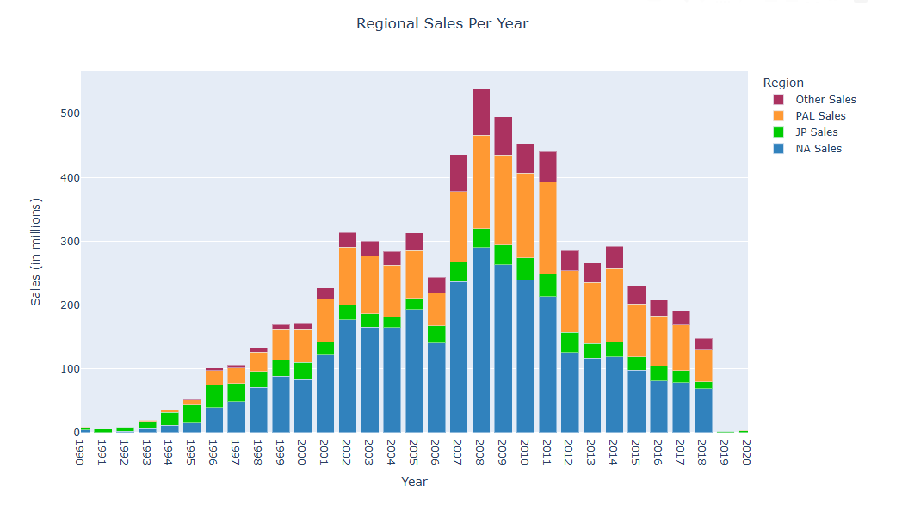
Regional Sales per Year
PAL (Phase Alternate Line)
JP (Japan)
NA (North America)
MARKET TREND REGION
Dominance in North America
Growth Surge in 90s – across all regions
Major boom from 2007s, especially in PAL
Gradual decrease post- 2010s
Notes:
I did a stacked bar chart. From the chart, we can see that there is a huge dominance in North America. In the 90s, there is a huge growth surge across all regions. This can be hugely attributed to the development of PCs in the 90s and the adoption of internet. There is a huge boom in the 2007s (where PS3 and Wii was released). I see a decrease in the early 2010s. The late 2000s and early 2010s had major development in smartphones.

Slide 9
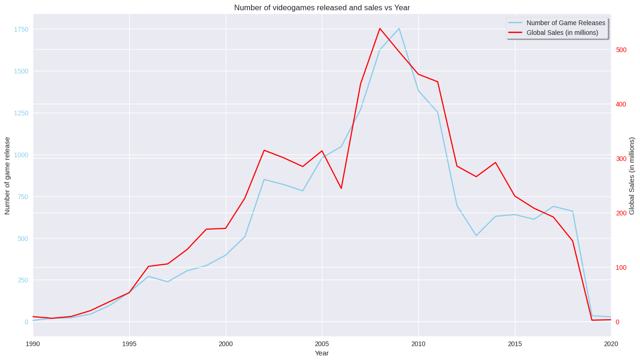
MARKET TREND - GAMES
Number of Games Released and Yearly Sales
Start of Smartphone Boom
Strong growth driven by high consumer demand and market growth
Gap driven by market saturation and increase in competition
Strong correlation between number of game releases and global sales
Notes:
Growth Period (1990-2010):
Number of Releases: Significant increase in game releases, peaking around 2010.
Global Sales: Corresponding rise in global sales, indicating high consumer demand and market growth.
Decline Period (Post-2010):
Number of Releases: Sharp decline in game releases after 2010.
Global Sales: Similar decline in global sales, suggesting changes in market dynamics.
Correlation:
Strong correlation between the number of game releases and global sales, both peaking around 2010 and declining thereafter.
Market Dynamics:
Growth Factors: Rise of major franchises, boom in console sales, and expansion of digital distribution platforms.
Decline Factors: Market saturation, increased competition, shifts towards mobile and indie games, and evolving consumer preferences.

Slide 10
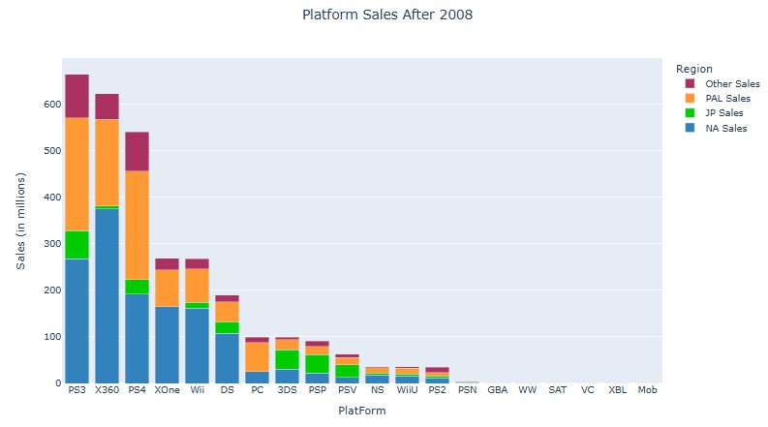
MARKET TREND – PLATFORM
Sales by Platform after 2008
Console | JP Sales
X360 | 6.87
PS3 | 60.46
PS4 | 30.69
XOne | 0.38
Wii | 12.36
DS | 25.35
3DS | 41.71
PSP | 39.19
Japan making up a huge proportion in sales on 3DS and PSP as compared to other platforms
Strong popularity for Playstation consoles
Stronger preference for handheld consoles in Japan

Slide 11
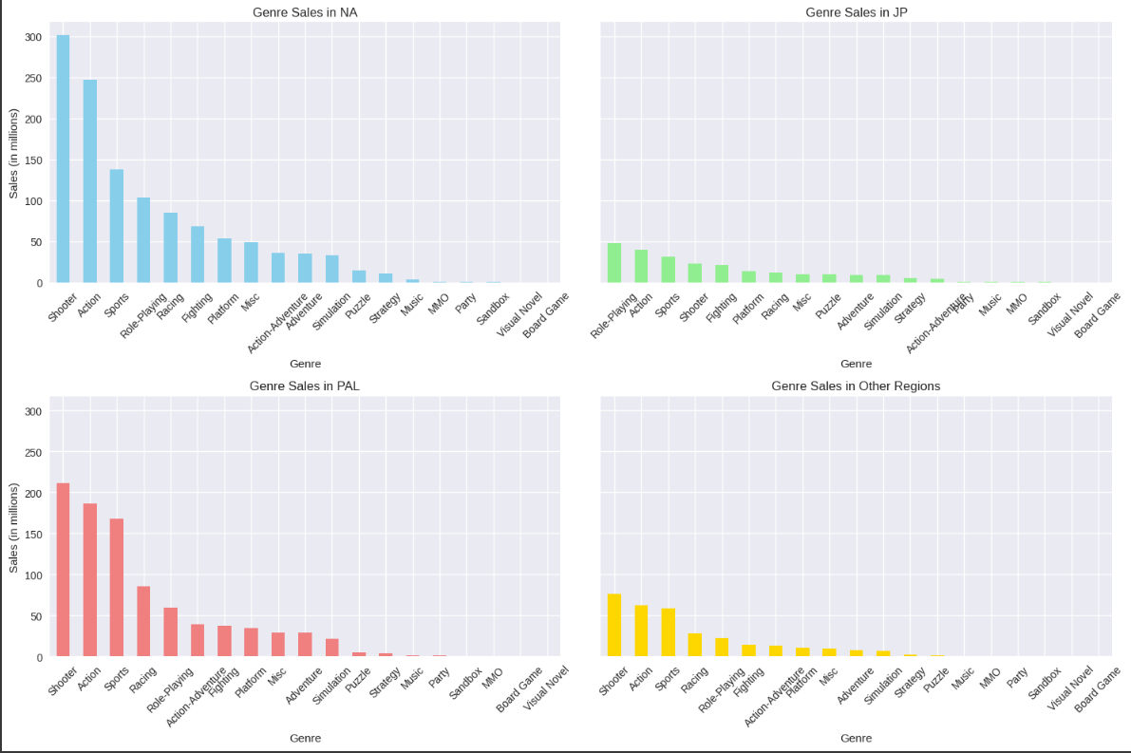
MARKET TREND GENRE
Strong preference for Shooter games in most regions

Slide 12

CALL OF DUTY
Call of Duty is a military styled first person shooter game that is published by Activision.
21 games in the main Call of Duty Series. First installation released in 2003
Available on most platforms (notable exception: Switch)
ACTIVISION
Founded in 1979 in California
Leading worldwide developer, publisher and distributor of interactive entertainment and products on consoles, mobile and PC
Citations: https://www.activision.com/company/aboutus
Notes:
https://www.activision.com/company/aboutus

Slide 13

INSIGHTS

Slide 14
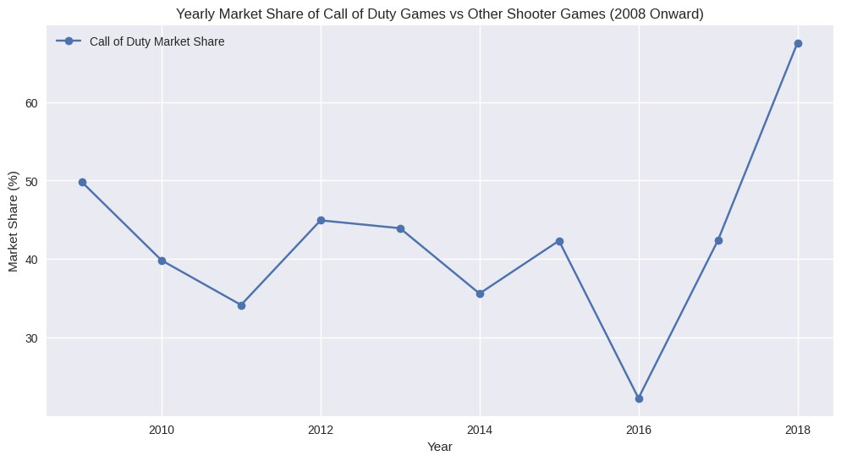
CALL OF DUTY – MARKET SHARE
Yearly Market Share of CoD in Shooting Game Genre
Increase in Market Share on Shooting Game Genre

Slide 15

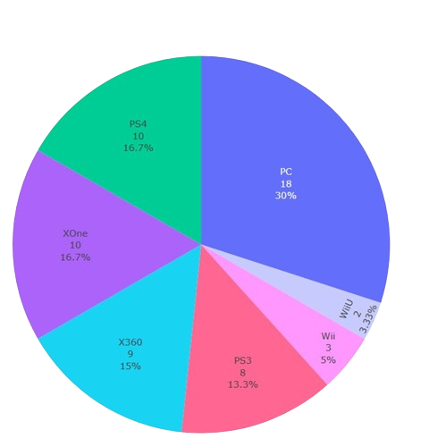
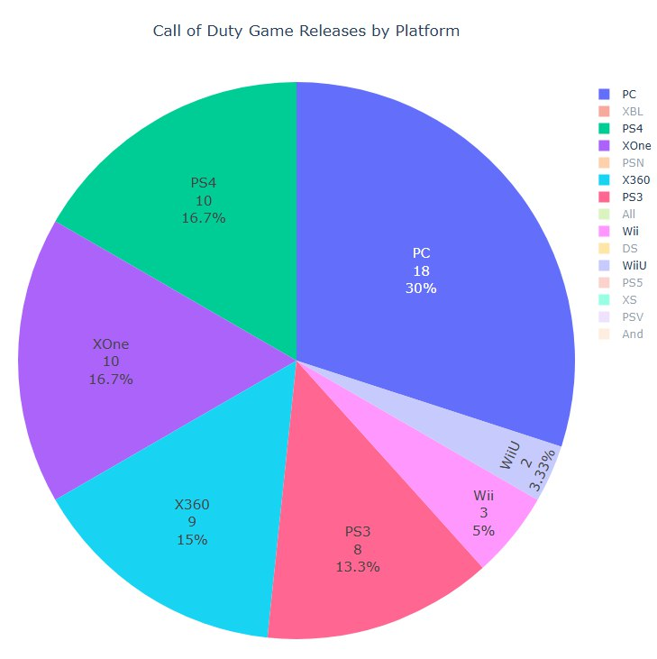
CALL OF DUTY PLATFORM
Main focus on PC and Traditional Gaming Consoles

Slide 16
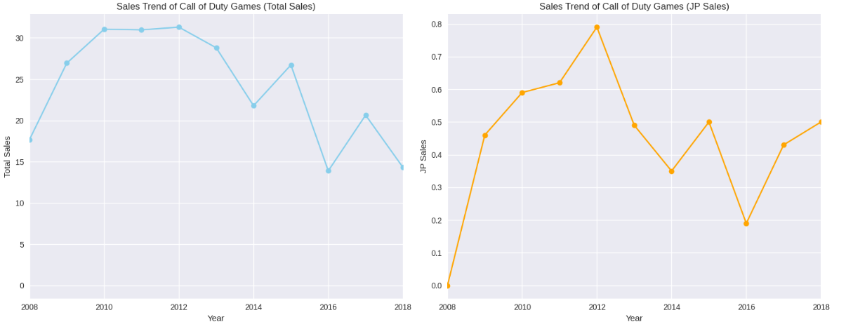
OPPORTUNITY – JAPAN MARKET
Sales Trend of Call of Duty Games (Total Sales) Sales Trend of Call of Duty Games (JP Sales)
Increasing demand in CoD games in Japan despite overall decrease in rest of the regions

Slide 17
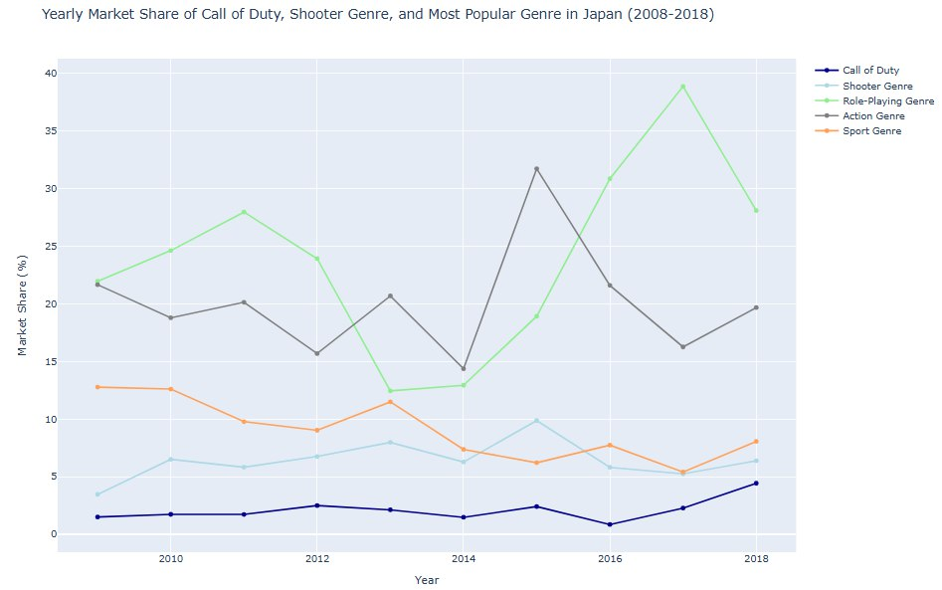
OPPORTUNITY – JAPAN MARKET
Yearly Market Share of CoD, Shooter Genre and Most Popular Genre in Japan
Yearly Market Share of CoD in Shooter Game Genre
Larger increase in CoD market share than in Shooter Game genre
- In line with our observation on the increase in CoD market share in shooter game genre

Slide 18

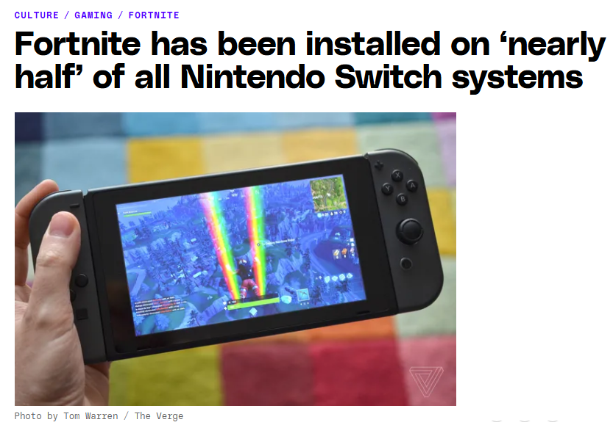

Widespread Appeal: Fortnite, a shooter game, is highly popular among Switch owners.
Significant Install Base: Installed on nearly half of the 22 million Switch units sold globally.
Global Reach: Popular not just in the US and Europe but also in Japan.
Rapid Growth: Significant increase from 2 million downloads in the first 24 hours after its June debut on the Switch.
Citations: https://www.theverge.com/2018/10/31/18047958/fortnite-nintendo-switch-downloads

Slide 19
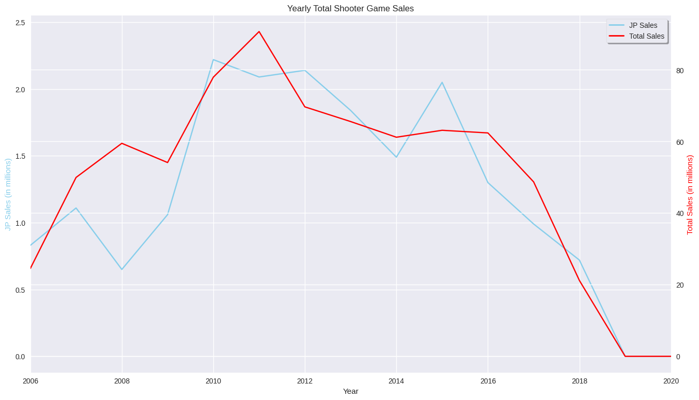
OPPORTUNITY – JAPAN MARKET
Release: New 3DS
Release: Switch
Release: Wii
Sales of shooter games in Japan are greatly impacted by handheld platform releases
Compatibility is important

Slide 20
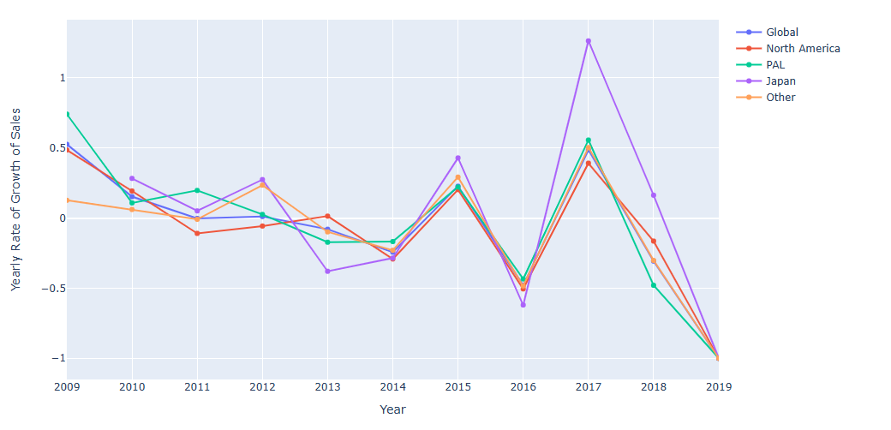
OPPORTUNITY – JAPAN MARKET
Rate of Growth of Yearly Sales for CoD Games
Release: Switch
Japan has high sensitivity to past releases of new handheld platforms
Larger change in growth rate of sales of CoD games in the region
Release: WiiU, PS Vita, 3DS

Slide 21

RECCOMENDATIONS

Slide 22

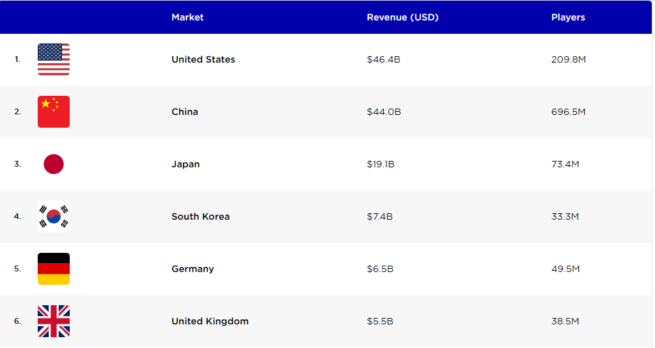
RECOMMENDATION
CoD games to be compatible with handheld devices such as Nintendo Switch
Japan is the 3rd biggest market in terms of game revenue.
Observation: Recent increase in demand of shooting games
Japan’s preference for handheld device
Citations: https://www.oneskyapp.com/blog/game-localization-agency/

Slide 23

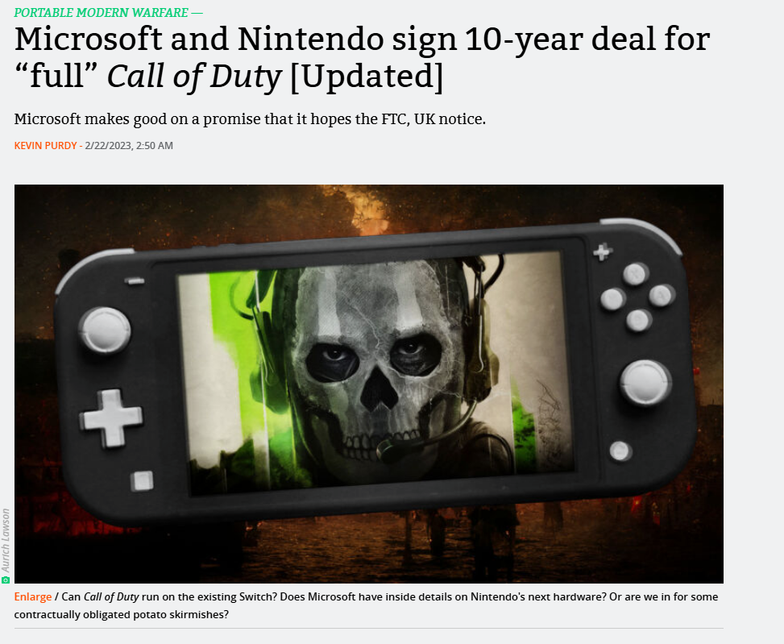
Microsoft appears to have made good on a promise to offer Call of Duty on Nintendo devices, a move seemingly aimed at calming antitrust concerns about its acquisition of Activision Blizzard.
Microsoft President and Vice-Chair Brad Smith tweeted the news early Tuesday morning, stating that Microsoft had "signed a binding 10-year contract to bring Xbox games to Nintendo's gamers." The contract is "just part of our commitment to bring Xbox games and Activision titles" to "more players on more platforms," Smith wrote.
Citations: https://arstechnica.com/gaming/2023/02/microsoft-signs-10-year-deal-with-nintendo-for-full-feature-call-of-duty//

Slide 24
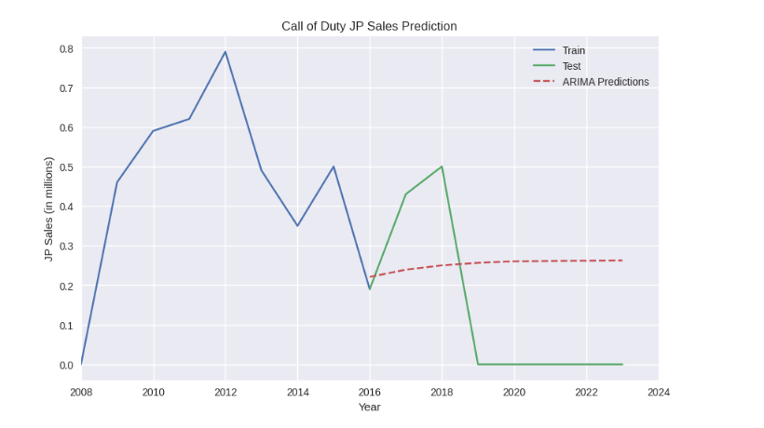
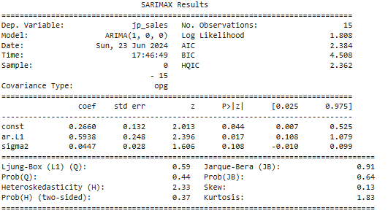
RECOMMENDATION – MACHINE LEARNING

Slide 25




SUMMARY
RECOMMENDATION Ensure Call of Duty games are compatible with popular handheld devices such as Nintendo Switch
Leverage the existing contract between Microsoft and Nintendo to bring Call of Duty to more players on newer platform
KEY OBSERVATIONS
KEY FACTS
Shooting Game Dominance Call of Duty remains a dominant force in the shooting game genre
Japan Market Correlation Notable correlation between the release of handheld consoles and the change in sales of Call of Duty games in Japan
Shooting Game Demand Recent trends show an increase in demand for shooting games in Japan
Large Market Japan is the third largest market for gaming revenue

Slide 26

THANK YOU

